Slide 1
Software Engineering & Project Management
21AIM61

Slide 2
Module 1 – Software engineering introduction
Software Engineering – Definition
Software life cycle activities
Challenges in System Development
Software process models: Waterfall, Prototyping, Evolutionary, spiral, unified and agile model
Software development methodology
Self-study / Case Study / Applications:
Investigate the Challenges of System Development, Compare any two Modern software development paradigms

Slide 3
Case study / self study
Investigate the Challenges of System Development, Compare any two Modern software development paradigms
Investigate Architectural design and compare any two testing techniques
Numerical Problems and case studies on:
Basic Effort Estimation
Function Points Estimation
CoCoMo II Estimation
Cost Benefit Analysis
Agile Estimation

Slide 4
Learning resources
Text Books:
Object Oriented Software Engineering, By David Kung edition 2018.
Software Project Management by Bob Hughes, Mike Cotterell and Rajib Mall, Fifth Edition, Tata McGraw Hill, New Delhi, 2015.
Software Engineering by Ian Sommerville,9th edition, 2012, Pearson Edu.
Software Engineering – A Practitioner’s Approach by Roger S Pressman,7thedition, 2014,
Software Project Management in Practice by Pankaj Jalote, 5thedition 2015
Reference Books:
Software Project Management: A Unified Framework” by Walker Royce.
Managing Global Software Projects McGraw Hill Education (India), Gopalaswamy Ramesh, Fourteenth Reprint 2013.
Effective Software Project Management by Robert K. Wysocki – Wiley Publication, 2011.

Slide 5
Introduction
Software engineering is a discipline that involves the application of systematic, disciplined, and quantifiable approaches to the development, operation, and maintenance of software systems.
Software engineering emphasizes the use of standardized processes, methodologies, tools, and techniques to manage complexity, ensure reliability, facilitate collaboration among team members, and achieve efficiency in software development projects
It also addresses broader considerations such as project management, quality assurance, and ethical responsibilities in software development.

Slide 6
Introduction
Why is Software Engineering required?
To manage large software
For more scalability
Cost management
To manage the dynamic nature of software
For better quality management

Slide 7
Introduction
Three parameters often drive and define a software project.
Cost: As the main cost of producing software is the manpower employed, the cost of developing software is generally measured in terms of person-months of effort spent in development. The productivity in the software industry for writing fresh code mostly ranges from a few hundred to about 1000 + LOC per person per month.
Schedule: The schedule is another important factor in many projects. Business trends are dictating that the time to market a product should be reduced; that is, the cycle time from concept to delivery should be small. This means that software needs to be developed faster and within the specified time.
Quality: Quality is one of the main mantras, and business strategies are designed around it. Developing high-quality software is another fundamental goal of software engineering.

Slide 8
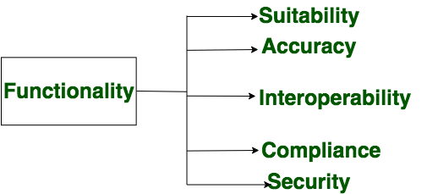
Introduction - Functionality
Functionality refers to the set of features and capabilities that a software program or system provides to its users. It is one of the most important characteristics of software, as it determines the usefulness of the software for the intended purpose. Examples of functionality in software include:
Data storage and retrieval
Data processing and manipulation
User interface and navigation
Communication and networking
Security and access control
Reporting and visualization
Automation and scripting

Slide 9
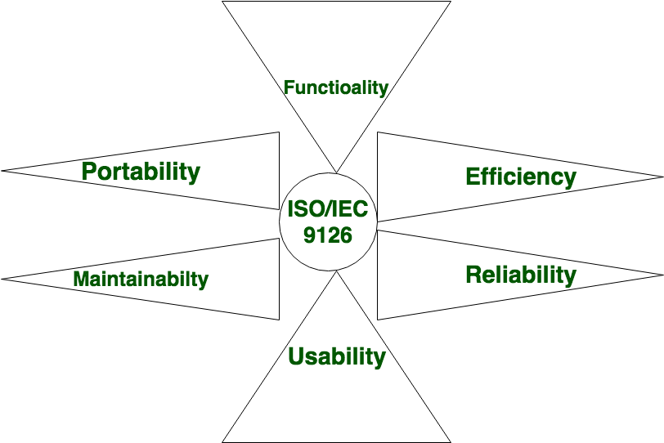
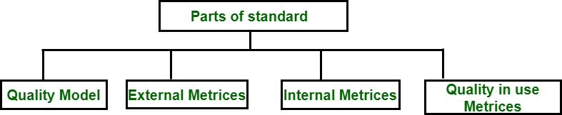
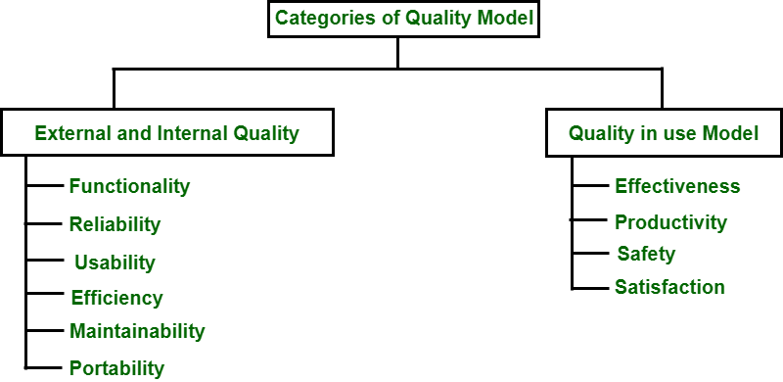
Introduction – quality attributes
ISO i.e. International Organization for Standardization and IEC i.e. International Electrotechnical Commission have developed ISO/IEC 9126 standards for software engineering → Product Quality to provide an all-inclusive specification and evaluation model for the quality of the software product.

Slide 10
Introduction
The international standard on software product quality suggests that six main attributes:
Reliability: The capability to provide failure-free service.
Functionality: The capability to provide functions that meet stated and implied needs when the software is used.
Usability: The capability to be understood, learned, and used.
Efficiency: The capability to provide appropriate performance relative to the amount of resources used.
Maintainability: the capability to be modified for purposes of making corrections, improvements, or adaptations.
Portability: The capability to be adapted for different specified environments without applying actions or means other than those provided for this purpose in the product.

Slide 11
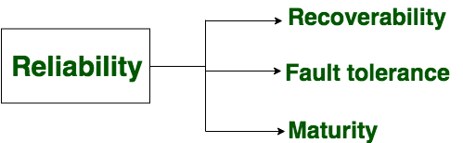
Introduction - reliability
A set of attributes that bears on the capability of software to maintain its level of performance under the given condition for a stated period of time.
Reliability is a characteristic of software that refers to its ability to perform its intended functions correctly and consistently over time. Reliability is an important aspect of software quality, as it helps ensure that the software will work correctly and not fail unexpectedly.
Bugs and errors in the code
Lack of testing and validation
Poorly designed algorithms and data structures
Inadequate error handling and recovery
Incompatibilities with other software or hardware

Slide 12
Introduction - efficiency
It refers to the ability of the software to use system resources in the most effective and efficient manner. The software should make effective use of storage space and executive command as per desired timing requirements.
Efficiency is a characteristic of software that refers to its ability to use resources such as memory, processing power, and network bandwidth in an optimal way. High efficiency means that a software program can perform its intended functions quickly and with minimal use of resources, while low efficiency means that a software program may be slow or consume excessive resources.
Examples:
Poorly designed algorithms and data structures
Inefficient use of memory and processing power
High network latency or bandwidth usage
Unnecessary processing or computation
Unoptimized code

Slide 13
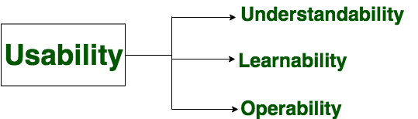
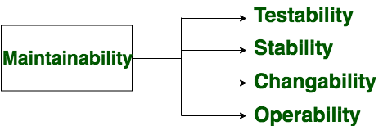
Introduction – usability & maintainability
It refers to the extent to which the software can be used with ease. the amount of effort or time required to learn how to use the software.
It refers to the ease with which modifications can be made in a software system to extend its functionality, improve its performance, or correct errors.

Slide 14
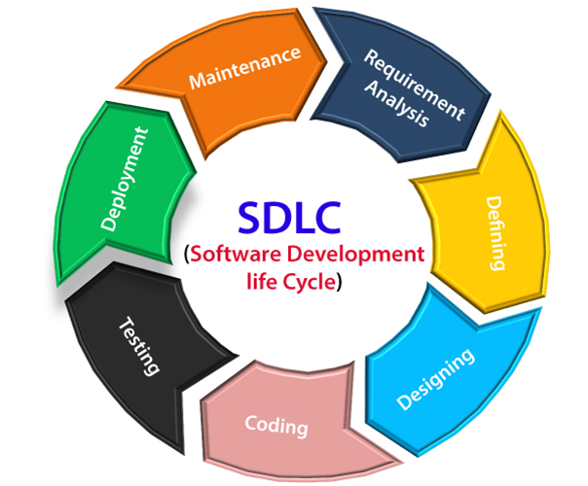
Software life cycle
Stage1: Planning and requirement analysis
Inputs from all the stakeholders and domain experts or SMEs in the industry
Planning for the quality assurance requirements
Identifications of the risks
Business analyst and Project organizer set up a meeting with the client to gather all the data like what the customer wants to build, who will be the end user, what is the objective of the product

Slide 15
Software life cycle
Stage2: Defining Requirements
Once the requirement analysis is done, the next stage is to certainly represent and document the software requirements and get them accepted from the project stakeholders.
This is accomplished through "SRS"- Software Requirement Specification document which contains all the product requirements to be constructed and developed during the project life cycle.
Stage3: Designing the Software
Bring down all the knowledge of requirements, analysis, and design of the software project.

Slide 16
Software life cycle
Stage4: Developing the project
The implementation of design begins concerning writing code.
Developers have to follow the coding guidelines described by their management
Stage5: Testing
After the code is generated, it is tested against the requirements to make sure that the products are solving the needs addressed and gathered during the requirements stage.
During this stage, unit testing, integration testing, system testing, acceptance testing are done.

Slide 17
Software life cycle
Stage6: Deployment
Once the software is certified, and no bugs or errors are stated, then it is deployed.
Then based on the assessment, the software may be released as it is or with suggested enhancement in the object segment.
After the software is deployed, then its maintenance begins.
Stage7: Maintenance
Once when the client starts using the developed systems, then the real issues come up and requirements to be solved from time to time.
This procedure where the care is taken for the developed product is known as maintenance.

Slide 18
Challenges in software development
Software project development can face numerous challenges, which can vary depending on factors such as project size, complexity, team dynamics, and external constraints. Some common challenges include:
Requirements Management: Gathering, understanding, and managing requirements from stakeholders can be challenging. Changes in requirements during the project lifecycle can lead to scope creep and affect project timelines and budgets.
Communication Issues: Effective communication among team members, stakeholders, and across different departments or teams is crucial for project success. Poor communication can lead to misunderstandings, delays, and conflicts.

Slide 19
Challenges in software development
Resource Constraints: Limited availability of skilled personnel, budget constraints, and tight deadlines can put pressure on project resources. Insufficient resources may affect the quality of deliverables and increase the risk of project failure.
Technical Complexity: Developing software solutions with complex architectures, integrations, or technologies can pose technical challenges. Technical complexity may lead to design flaws, performance issues, and difficulties in implementation and maintenance.
Scope Creep: Changes in project scope or requirements after the project has started can lead to scope creep. Managing scope creep requires careful planning, communication, and change control processes to prevent negative impacts on project objectives.

Slide 20
Challenges in software development
Risk Management: Identifying, assessing, and mitigating project risks is essential for minimizing the impact of unforeseen events or issues. Failure to manage risks effectively can lead to project delays, budget overruns, or even project failure.
Quality Assurance: Ensuring the quality of software deliverables through comprehensive testing and quality assurance processes is challenging. Inadequate testing or QA practices can result in defects, bugs, and user dissatisfaction.
Project Management: Effective project management is critical for coordinating project activities, managing resources, and monitoring progress. Poor project management practices can lead to missed deadlines, budget overruns, and project failure.

Slide 21
Challenges in software development
Stakeholder Management: Engaging and managing stakeholders throughout the project lifecycle is essential for ensuring their support and satisfaction. Failure to address stakeholder concerns or expectations can lead to conflicts and project delays.
Technology Changes: Rapid advancements in technology and evolving industry trends can pose challenges for software projects. Keeping up with technology changes requires continuous learning, adaptation, and sometimes reevaluation of project plans and strategies.
Addressing these challenges requires a combination of effective planning, communication, risk management, and collaboration among project stakeholders. Adhering to best practices in software development and project management can help mitigate risks and improve the likelihood of project success.

Slide 22
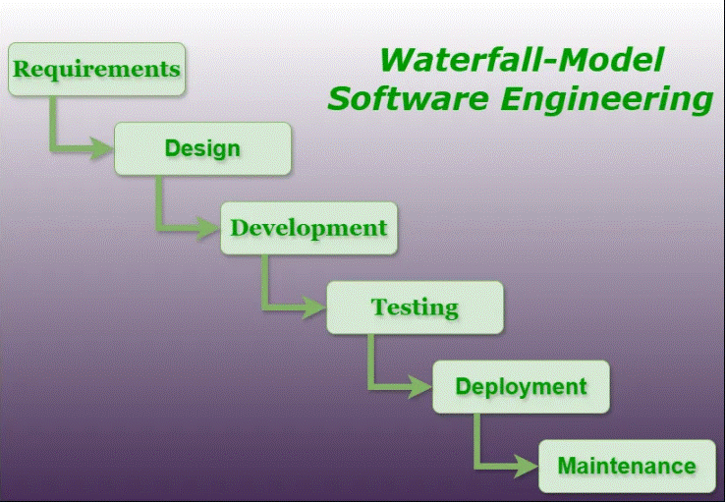
Software process models - Waterfall
In this method, the whole process of software development is divided into various phases.
The waterfall model is a continuous software development model in which development is seen as flowing steadily downwards (like a waterfall) through the steps of requirements analysis, design, implementation, testing (validation), integration, and maintenance.
Linear ordering of activities has some significant consequences. First, to identify the end of a phase and the beginning of the next, some certification techniques have to be employed at the end of each step. Some verification and validation usually do this mean that will ensure that the output of the stage is consistent with its input (which is the output of the previous step), and that the output of the stage is consistent with the overall requirements of the system.
The model is highly structured, making it easy to understand and use

Slide 23
Software process models - Waterfall
Advantages of the Waterfall model
Simplicity: The linear and sequential nature of the Waterfall models makes it easy to understand and implement.
Clear Documentation: Each phase has its own set of documentation, making it easier to track progress and manage the project.
Stable Requirements: Well-suited for projects with stable and well-defined requirements at the beginning.
Predictability: Due to its structured nature, the Waterfall model allows for better predictability in terms of timelines and deliverables.

Slide 24
Software process models - Waterfall
Disadvantages of the Waterfall SDLC Models:
Rigidity: The model is highly inflexible once a phase is completed, making it challenging to accommodate changes.
Late Testing: Testing is performed after the implementation phase, so defects might not be discovered until late in the process.
Limited Client Involvement: Clients are involved mainly in the initial phase, and significant changes cannot be easily accommodated later in the development process.
No Prototyping: The models lack the provision for creating prototypes, which could be a disadvantage in projects where user feedback is crucial.

Slide 25
Software process models - Waterfall
When to Use the Waterfall SDLC Models:
Well-Defined Requirements: When project requirements are clear, stable, and unlikely to change significantly.
Small to Medium-Sized Projects: For smaller projects with straightforward objectives and limited complexity.
Mission-Critical Systems: In scenarios where it is crucial to have a well-documented and predictable development process, especially for mission-critical systems.

Slide 26
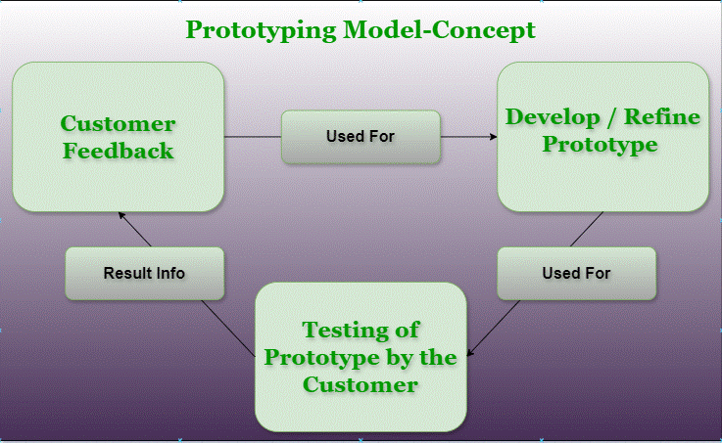
Prototyping model
Prototyping is defined as the process of developing a working replication of a product or system that has to be engineered.
This model is used when the customers do not know the exact project requirements beforehand. In this model, a prototype of the end product is first developed, tested, and refined as per customer feedback repeatedly till a final acceptable prototype is achieved which forms the basis for developing the final product.

Slide 27
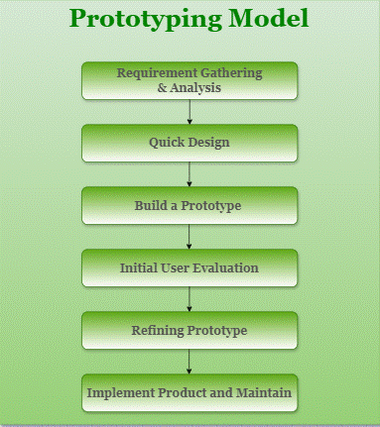
Prototyping model
Steps of Prototyping Model
Step 1: Requirement Gathering and Analysis: This is the initial step in designing a prototype model. In this phase, users are asked about what they expect or what they want from the system.
Step 2: Quick Design: This is the second step in the Prototyping Model. This model covers the basic design of the requirement through which a quick overview can be easily described.
Step 3: Build a Prototype: This step helps in building an actual prototype from the knowledge gained from prototype design.
Step 4: Initial User Evaluation: This step describes the preliminary testing where the investigation of the performance model occurs, as the customer will tell the strengths and weaknesses of the design, which was sent to the developer.
Step 5: Refining Prototype: If any feedback is given by the user, then improving the client’s response to feedback and suggestions, the final system is approved.
Step 6: Implement Product and Maintain: This is the final step in the phase of the Prototyping Model where the final system is tested and distributed to production, here the program is run regularly to prevent failures.

Slide 28
Prototyping model
Types of Prototyping Models
There are four types of Prototyping Models, which are described below.
Rapid Throwaway Prototyping
Evolutionary Prototyping
Incremental Prototyping
Extreme Prototyping
Rapid Throwaway Prototyping
This technique offers a useful method of exploring ideas and getting customer feedback for each of them.
In this method, a developed prototype need not necessarily be a part of the accepted prototype.
Customer feedback helps prevent unnecessary design faults and hence, the final prototype developed is of better quality.

Slide 29
Prototyping model
Evolutionary Prototyping
In this method, the prototype developed initially is incrementally refined based on customer feedback till it finally gets accepted.
In comparison to Rapid Throwaway Prototyping, it offers a better approach that saves time as well as effort.
This is because developing a prototype from scratch for every iteration of the process can sometimes be very frustrating for the developers.
Incremental Prototyping
In this type of incremental prototyping, the final expected product is broken into different small pieces of prototypes and developed individually.
In the end, when all individual pieces are properly developed, then the different prototypes are collectively merged into a single final product in their predefined order.
Incremental Prototyping
It’s a very efficient approach that reduces the complexity of the development process, where the goal is divided into sub-parts and each sub-part is developed individually.
The time interval between the project’s beginning and final delivery is substantially reduced because all parts of the system are prototyped and tested simultaneously.
Of course, there might be the possibility that the pieces just do not fit together due to some lack of ness in the development phase – this can only be fixed by careful and complete plotting of the entire system before prototyping starts.

Slide 30
Prototyping model
Extreme Prototyping
This method is mainly used for web development. It consists of three sequential independent phases:
In this phase, a basic prototype with all the existing static pages is presented in HTML format.
In the 2nd phase, Functional screens are made with a simulated data process using a prototype services layer.
This is the final step where all the services are implemented and associated with the final prototype.
Advantages of Prototyping Model
The customers get to see the partial product early in the life cycle. This ensures a greater level of customer satisfaction and comfort
New requirements can be easily accommodated as there is scope for refinement
Missing functionalities can be easily figured out
Errors can be detected much earlier thereby saving a lot of effort and cost, besides enhancing the quality of the software.
The developed prototype can be reused by the developer for more complicated projects in the future.
Flexibility in design
Early feedback from customers and stakeholders can help guide the development process

Slide 31
Prototyping model - advantages
The developed prototype can be reused by the developer for more complicated projects in the future.
Flexibility in design
Early feedback from customers and stakeholders can help guide the development process and ensure that the final product meets their needs and expectations.
Prototyping can be used to test and validate design decisions, allowing for adjustments to be made before significant resources are invested in development.
Prototyping can help reduce the risk of project failure by identifying potential issues and addressing them early in the process.
Prototyping can facilitate communication and collaboration among team members and stakeholders, improving overall project efficiency and effectiveness.
Prototyping can help bridge the gap between technical and non-technical stakeholders by providing a tangible representation of the product.

Slide 32
Prototyping model
Disadvantages of the Prototyping Model
Costly concerning time as well as money.
There may be too much variation in requirements each time the prototype is evaluated by the customer.
Poor Documentation due to continuously changing customer requirements.
It is very difficult for developers to accommodate all the changes demanded by the customer.
There is uncertainty in determining the number of iterations that would be required before the prototype is finally accepted by the customer.
Disadvantages of the Prototyping Model
After seeing an early prototype, the customers sometimes demand the actual product to be delivered soon.
Developers in a hurry to build prototypes may end up with sub-optimal solutions.
The customer might lose interest in the product if he/she is not satisfied with the initial prototype.
The prototype may not be scalable to meet the future needs of the customer.
The prototype may not accurately represent the final product due to limited functionality or incomplete features.
The focus on prototype development may shift away from the final product, leading to delays in the development process.

Slide 33
Prototyping model
Applications of Prototyping Model
The Prototyping Model should be used when the requirements of the product are not clearly understood or are unstable.
The prototyping model can also be used if requirements are changing quickly.
This model can be successfully used for developing user interfaces, high-technology software-intensive systems, and systems with complex algorithms and interfaces.
The prototyping Model is also a very good choice to demonstrate the technical feasibility of the product.

Slide 34
Evolutionary Model
The concept of the evolutionary model in software engineering came into picture when the users wanted to experience the partially developed system rather than waiting for the fully developed version.
The evolutionary model is based on the idea of developing the core modules, then gradually improving the software product over time using incremental and iterative techniques with appropriate feedback.
In this type of process model, successive versions of the product are made through several iterations and come up when the final product is built through multiple iterations.
The evolutionary approach suggests breaking down modules into maintainable smaller chunks, prioritizing them and then delivering those chunks one at a time to the users.

Slide 35
Evolutionary Model - characteristics
Each evolutionary model may be developed using an iterative waterfall model of development.
Evolutionary models include three types- Iterative model, Incremental model and Spiral model.
The models require several primary needs and architectural planning that must be done.
The new release of the product may include new functionality and also a modification in the existing functionality.
This model allows for changing requirements as well as dividing the development process into different manageable work modules.
The development team responds to customer feedback on the product throughout the planning phase of the next cycle, frequently by altering the product, strategy, or process.

Slide 36
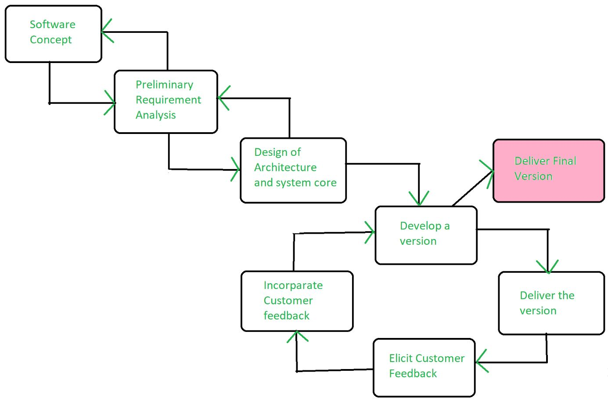
Evolutionary Model

Slide 37
Evolutionary Model - characteristics
Advantages Evolutionary Model
Adaptability to Changing Requirements: Evolutionary models work effectively in projects when the requirements are ambiguous or change often. They support adjustments and flexibility along the course of development.
Early and Gradual Distribution: Functional components or prototypes can be delivered early thanks to incremental development. Faster user satisfaction and feedback may result from this.
User Commentary and Involvement: Evolutionary models place a strong emphasis on ongoing user input and participation. This guarantees that the software offered closely matches the needs and expectations of the user.
Improved Handling of Difficult Projects: Big, complex tasks can be effectively managed with the help of evolutionary models. The development process is made simpler by segmenting the project into smaller, easier-to-manage portions.

Slide 38
Evolutionary Model - characteristics
Disadvantages Evolutionary Model
Communication Difficulties: Evolutionary models require constant cooperation and communication. The strategy may be less effective if there are gaps in communication or if team members are spread out geographically.
Dependence on an Expert Group: A knowledgeable and experienced group that can quickly adjust to changes is needed for evolutionary models. Teams lacking experience may find it difficult to handle these model’s dynamic nature.
Increasing Management Complexity: Complexity can be introduced by organizing and managing several increments or iterations, particularly in large projects. In order to guarantee integration and synchronization, good project management is needed.
Greater Initial Expenditure: As evolutionary models necessitate continual testing, user feedback and prototyping, they may come with a greater starting cost. This may be a problem for projects that have limited funding.

Slide 39
Spiral model
The spiral model is an SDLC model that combines elements of an iterative software development model with a waterfall model. It is advisable to use this model for expensive, large and complex projects.
In the spiral model, each loop may not result in deliverable software. In the incremental model, every increment actually leads to a deployable increment at the customer site, one of the major differences between the spiral and incremental models.
In the prototyping model, the risks which can be identified upfront can be handled, but in the spiral model, the risks which appear after the development start can be handled better.

Slide 40
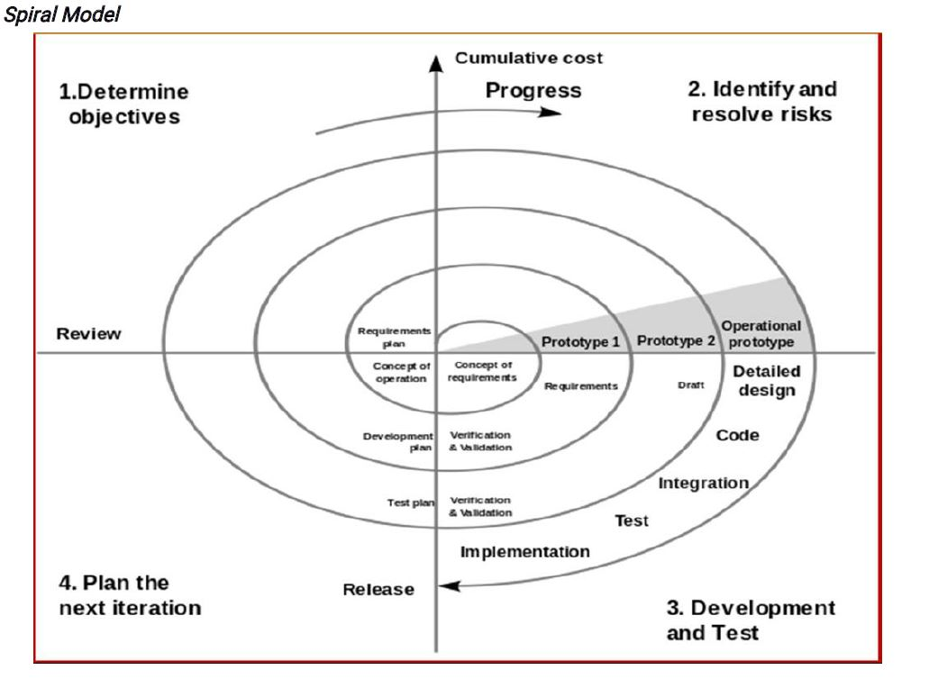
Spiral model phases
The Spiral Model is a risk-driven model, meaning that the focus is on managing risk through multiple iterations of the software development process.
It has four stages or phases: The planning of objectives, risk analysis, engineering or development, and finally review. A project passes through all these stages repeatedly and the phases are known as a Spiral in the model.
Determine objectives and find alternate solutions – This phase includes requirement gathering and analysis. Based on the requirements, objectives are defined and different alternate solutions are proposed.
Risk Analysis and resolving – In this quadrant, all the proposed solutions are analyzed and any potential risk is identified, analyzed, and resolved.

Slide 41
Spiral model phases
Develop and test: This phase includes the actual implementation of the different features. All the implemented features are then verified with thorough testing.
Review and planning of the next phase – In this phase, the software is evaluated by the customer. It also includes risk identification and monitoring like cost overrun or schedule slippage and after that planning of the next phase is started.
The Spiral model is called a Meta-Model because it subsumes all the other SDLC models. For example, a single loop spiral actually represents the Iterative Waterfall Model.
The spiral model incorporates the stepwise approach of the Classical Waterfall Model.
The spiral model uses the approach of the Prototyping Model by building a prototype at the start of each phase as a risk-handling technique.
Also, the spiral model can be considered as supporting the Evolutionary model – the iterations along the spiral can be considered as evolutionary levels through which the complete system is built.

Slide 42
Spiral model - advantages
Risk Handling: The projects with many unknown risks that occur as the development proceeds, in that case, Spiral Model is the best development model to follow due to the risk analysis and risk handling at every phase.
Good for large projects: It is recommended to use the Spiral Model in large and complex projects.
Flexibility in Requirements: Change requests in the Requirements at a later phase can be incorporated accurately by using this model.
Customer Satisfaction: Customers can see the development of the product at the early phase of the software development and thus, they habituated with the system by using it before completion of the total product.
Iterative and Incremental Approach: The Spiral Model provides an iterative and incremental approach to software development, allowing for flexibility and adaptability in response to changing requirements or unexpected events.

Slide 43
Spiral model - advantages
Emphasis on Risk Management: The Spiral Model places a strong emphasis on risk management, which helps to minimize the impact of uncertainty and risk on the software development process.
Improved Communication: The Spiral Model provides for regular evaluations and reviews, which can improve communication between the customer and the development team.
Improved Quality: The Spiral Model allows for multiple iterations of the software development process, which can result in improved software quality and reliability.

Slide 44
Spiral model - disadvantages
Complex: The Spiral Model is much more complex than other SDLC models.
Expensive: Spiral Model is not suitable for small projects as it is expensive.
Too much dependability on Risk Analysis: The successful completion of the project is very much dependent on Risk Analysis. Without very highly experienced experts, it is going to be a failure to develop a project using this model.
Difficulty in time management: As the number of phases is unknown at the start of the project, time estimation is very difficult.
Complexity: The Spiral Model can be complex, as it involves multiple iterations of the software development process.
Time-Consuming: The Spiral Model can be time-consuming, as it requires multiple evaluations and reviews.
Resource Intensive: The Spiral Model can be resource-intensive, as it requires a significant investment in planning, risk analysis, and evaluations.

Slide 45
Spiral model - disadvantages
When To Use the Spiral Model?
When a project is vast in software engineering, a spiral model is utilized.
A spiral approach is utilized when frequent releases are necessary.
When it is appropriate to create a prototype
When evaluating risks and costs is crucial
The spiral approach is beneficial for projects with moderate to high risk.
The SDLC’s spiral model is helpful when requirements are complicated and ambiguous.
If modifications are possible at any moment
When committing to a long-term project is impractical owing to shifting economic priorities.

Slide 46
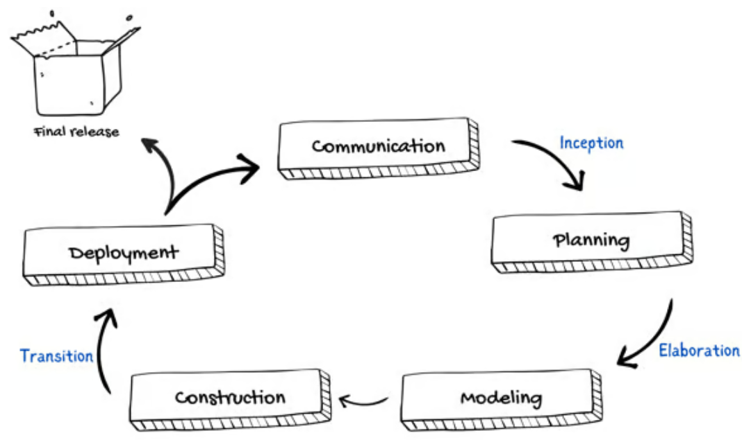
Unified model
The Unified Process (UP) is a software development framework used for object-oriented modeling. The framework is also known as Rational Unified Process (RUP) and the Open Unified Process (Open UP). Some of the key features of this process include:
It defines the order of phases.
It is component-based, meaning a software system is built as a set of software components. There must be well-defined interfaces between the components for smooth communication.
It follows an iterative, incremental, architecture-centric, and use-case driven approach

Slide 47
Unified model
The case-driven approach
Use a case-driven approach that follows a set of actions performed by one or more entities.
A use case refers to the process of the team performing the development work from the functional requirements.
The functional requirements are made from the list of requirements that were specified by the client.
For example, an online learning management system can be specified in terms of use cases such as "add a course," "delete a course," "pay fees," and so on.
The architecture-centric approach
The architecture-centric approach defines the form of the system and how it should be structured to provide a specific functionality whereas the use case defines the functionality.

Slide 48
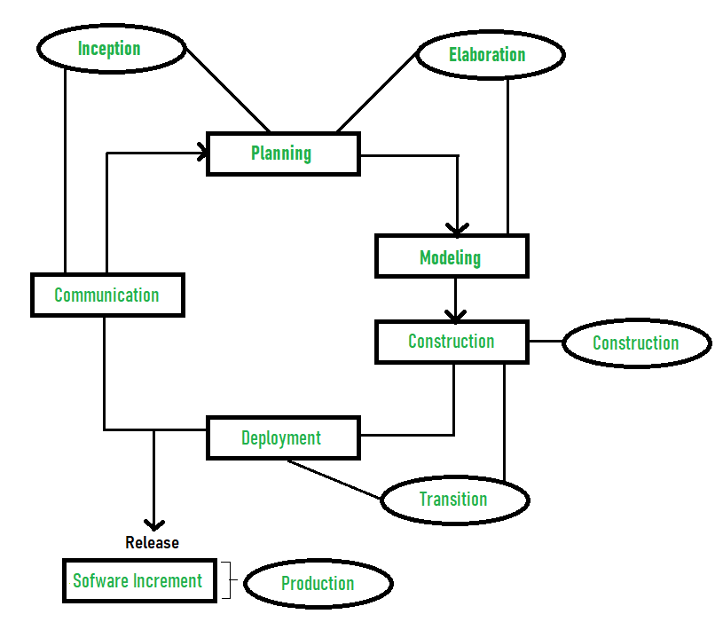
Unified model - Phases
We can represent a unified process model as a series of cycles. Each cycle ends with the release of a new system version for the customers. We have four phases in every cycle:
Inception
Elaboration
Construction
Transition

Slide 49
Unified model - Phases
Inception
Communication and planning are the main ones.
Identifies the scope of the project using a use-case model allowing managers to estimate costs and time required.
Customers’ requirements are identified and then it becomes easy to make a plan for the project.
The project plan, Project goal, risks, use-case model, and Project description, are made.
The project is checked against the milestone criteria and if it couldn’t pass these criteria then the project can be either canceled or redesigned.
Elaboration
Planning and modeling are the main ones.
A detailed evaluation and development plan is carried out and diminishes the risks.
Revise or redefine the use-case model (approx. 80%), business case, and risks.
Again, checked against milestone criteria and if it couldn’t pass these criteria then again project can be canceled or redesigned.
Executable architecture baseline.

Slide 50
Unified model - Phases
Construction
The project is developed and completed.
System or source code is created and then testing is done.
Coding takes place.
Transition
The final project is released to the public.
Transit the project from development into production.
Update project documentation.
Beta testing is conducted.
Defects are removed from the project based on feedback from the public.
Advantages:
It provides good documentation, it completes the process in itself.
It provides risk-management support.
It reuses the components, and hence total time duration is less.
Good online support is available in the form of tutorials and training.
Disadvantages:
Team of expert professional is required, as the process is complex.
Complex and not properly organized process.
More dependency on risk management.
Hard to integrate again and again.

Slide 51
Agile model
"Agile process model" refers to a software development approach based on iterative development.
Agile methods break tasks into smaller iterations, or parts do not directly involve long term planning.
The project scope and requirements are laid down at the beginning of the development process.
Plans regarding the number of iterations, the duration and the scope of each iteration are clearly defined in advance.
Each iteration is considered as a short time "frame" in the Agile process model, which typically lasts from one to four weeks.
The division of the entire project into smaller parts helps to minimize the project risk and to reduce the overall project delivery time requirements.
Each iteration involves a team working through a full software development life cycle including planning, requirements analysis, design, coding, and testing before a working product is demonstrated to the client.

Slide 52
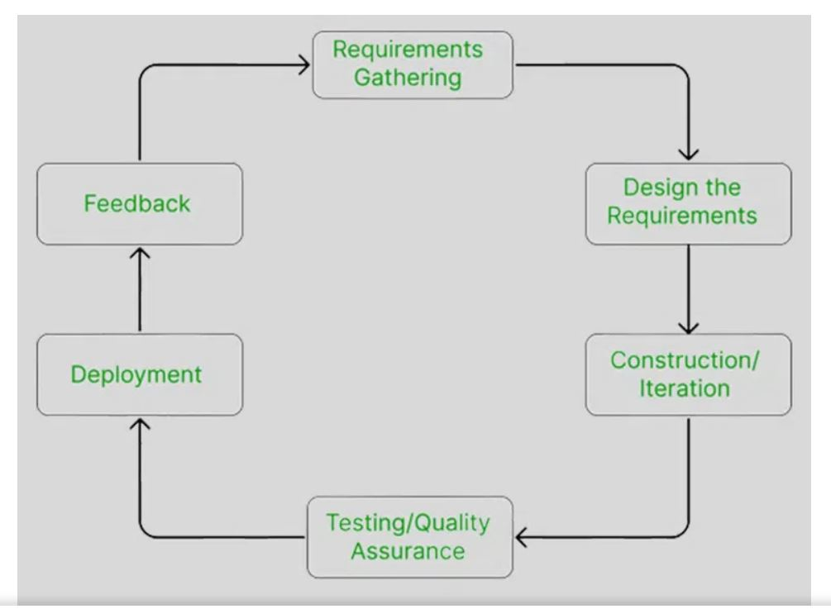
Agile model
Requirement Gathering:- In this step, the development team must gather the requirements, by interaction with the customer. development team should plan the time and effort needed to build the project. Based on this information you can evaluate technical and economical feasibility.
Design the Requirements:- In this step, the development team will use user-flow-diagram or high-level UML diagrams to show the working of the new features and show how they will apply to the existing software. Wireframing and designing user interfaces are done in this phase.
Construction / Iteration:- In this step, development team members start working on their project, which aims to deploy a working product.

Slide 53
Agile model
Testing / Quality Assurance:- Testing involves Unit Testing, Integration Testing, and System Testing.
Unit Testing:- Unit testing is the process of checking small pieces of code to ensure that the individual parts of a program work properly on their own. Unit testing is used to test individual blocks (units) of code
Integration Testing:- Integration testing is used to identify and resolve any issues that may arise when different units of the software are combined.
System Testing:- Goal is to ensure that the software meets the requirements of the users and that it works correctly in all possible scenarios.
Deployment:- In this step, the development team will deploy the working project to end users.
Feedback:- This is the last step of the Agile Model. In this, the team receives feedback about the product and works on correcting bugs based on feedback provided by the customer

Slide 54
Agile model - Principles
To establish close contact with the customer during development and to gain a clear understanding of various requirements, each Agile project usually includes a customer representative on the team. At the end of each iteration stakeholders and the customer representative review, the progress made and re-evaluate the requirements.
The agile model relies on working software deployment rather than comprehensive documentation.
Frequent delivery of incremental versions of the software to the customer representative in intervals of a few weeks.
Requirement change requests from the customer are encouraged and efficiently incorporated.
It emphasizes having efficient team members and enhancing communications among them is given more importance. It is realized that improved communication among the development team members can be achieved through face-to-face communication rather than through the exchange of formal documents.
It is recommended that the development team size should be kept small (5 to 9 people) to help the team members meaningfully engage in face-to-face communication and have a collaborative work environment.

Slide 55
Agile model - Characteristics
Agile processes must be adaptable to technical and environmental changes. That means if any technological changes occur, then the agile process must accommodate them.
The development of agile processes must be incremental. That means, in each development, the increment should contain some functionality that can be tested and verified by the customer.
The customer feedback must be used to create the next increment of the process.
The software increment must be delivered in a short span of time.
It must be iterative so that each increment can be evaluated regularly.

Slide 56
Agile model - Advantages
Working through Pair programming produces well-written compact programs which have fewer errors as compared to programmers working alone.
It reduces the total development time of the whole project.
Agile development emphasizes face-to-face communication among team members, leading to better collaboration and understanding of project goals.
Customer representatives get the idea of updated software products after each iteration. So, it is easy for him to change any requirement if needed.
Agile development puts the customer at the center of the development process, ensuring that the end product meets their needs.

Slide 57
Agile model - disadvantages
The lack of formal documents creates confusion and important decisions taken during different phases can be misinterpreted at any time by different team members.
It is not suitable for handling complex dependencies.
The agile model depends highly on customer interactions so if the customer is not clear, then the development team can be driven in the wrong direction.
Agile development models often involve working in short sprints, which can make it difficult to plan and forecast project timelines and deliverables. This can lead to delays in the project and can make it difficult to accurately estimate the costs and resources needed for the project.
Agile development models require a high degree of expertise from team members, as they need to be able to adapt to changing requirements and work in an iterative environment. This can be challenging for teams that are not experienced in agile development practices and can lead to delays and difficulties in the project.
Due to the absence of proper documentation, when the project completes and the developers are assigned to another project, maintenance of the developed project can become a problem.

Slide 58
Software development methodology
There are multiple types of Software development methodologies available and we will learn the following development methodologies.
Lean Development
Scrum Methodology
Behavior Driven Development
Feature Driven Development
Extreme Programming (XP)

Slide 59
Lean development
Lean principles (Toyota Production System) got their start in manufacturing, as a way to optimize the production line to minimize waste and maximize value to the customer. These two goals are also relevant to software development, which also:
Follows a repeatable process
Requires particular quality standards
Relies on the collaboration of a group of specialized workers
Applying Lean principles to knowledge work requires a shift in mindset in terms of how value, waste, and other key Lean concepts are defined.
The seven Lean principles are: 1) Eliminate waste 2) Build quality in 3) Create knowledge, 4) Defer commitment, 5) Deliver fast, 6) Respect people, 7) Optimize the whole

Slide 60
Lean development
Eliminate waste:
Unnecessary code or functionality: Delays time to customer, slows down feedback loops
Starting more than can be completed: Adds unnecessary complexity to the system, results in context-switching, handoff delays, and other impediments to flow
Delay in the software development process: Delays time to customer, slows down feedback loops
Unclear or constantly changing requirements: Results in rework, frustration, quality issues, lack of focus
Bureaucracy: Delays speed
Slow or ineffective communication: Results in delays, frustrations, and poor communication to stakeholders which can impact IT’s reputation in the organization
Partially done work: Does not add value to the customer or allow team to learn from work
Defects and quality issues: Results in rework, abandoned work, and poor customer satisfaction
Task switching: Results in poor work quality, delays, communication breakdowns, and low team morale

Slide 61
Lean development
Build quality in:
In trying to ensure quality, many teams actually create waste – through excessive testing, for example, or an excessive logging of defects.
Most popular Lean development tools:
Pair programming: Avoid quality issues by combining the skills and experience of two developers instead of one
Test-driven development: Writing criteria for code before writing the code to ensure it meets business requirements
Incremental development and constant feedback
Minimize wait states: Reduce context switching, knowledge gaps, and lack of focus
Automation: Automate any tedious, manual process or any process prone to human error

Slide 62
Lean development
Create knowledge
This principle encourages Lean teams to provide the infrastructure to properly document and retain valuable learning. This can be done by using any combination of the following tools:
Pair programming
Code reviews
Documentation
Wiki – to let the knowledge base build up incrementally
Thoroughly commented code
Knowledge sharing sessions
Training
Use tools to manage requirements or user stories

Slide 63
Lean development
Defer commitment
This Lean principle encourages team to demonstrate responsibility by keeping their options open and continuously collecting information, rather than making decisions without the necessary data.
To defer commitment means to:
Not plan (in excessive detail) for months in advance
Not commit to ideas or projects without a full understanding of the business requirements
Constantly be collecting and analyzing information regarding any important decisions

Slide 64
Lean development
Deliver fast
Thinking too far in advance about future requirements
Blockers that aren’t responded to with urgency
Over-engineering solutions and business requirements
Lean development is based on this concept: Build a simple solution, put it in front of customers, enhance incrementally based on customer feedback.
Respect people
Communicating proactively and effectively
Encouraging healthy conflict
Surfacing any work-related issues as a team
Empowering each other to do their best work

Slide 65
Lean development
Optimize the whole
Suboptimization is a serious issue in software development
The first is releasing sloppy code for the sake of speed. When developers feel pressured to deliver at all costs, they release code that may or may not meet quality requirements. This increases the complexity of the code base, resulting in more defects. With more defects, there is more work to do, putting more pressure on developers to deliver quickly… so the cycle continues.
The second is an issue with testing. When testers are overloaded, it creates a long cycle time between when developers write code and when testers are able to give feedback on it.

Slide 66
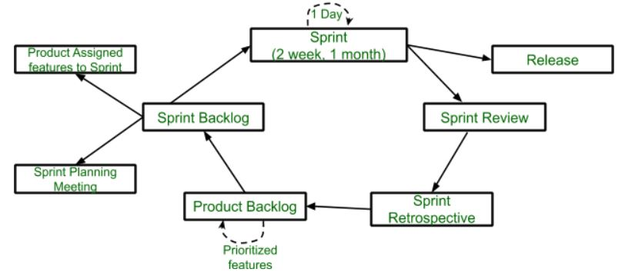
Scrum Methodology
sdsdf

Slide 67
Scrum Methodology
Scrum is the type of Agile framework. It is a framework within which people can address complex adaptive problem while productivity and creativity of delivering product is at highest possible values.
Scrum uses Iterative process.
Features of Scrum
Scrum is light-weighted framework
Scrum emphasizes self-organization
Scrum is simple to understand
Scrum framework help the team to work together

Slide 68
Scrum Methodology
Sprint: A Sprint is a time box of one month or less. A new Sprint starts immediately after the completion of the previous Sprint.
Release: When the product is completed, it goes to the Release stage.
Sprint Review: If the product still has some non-achievable features, it will be checked in this stage and then passed to the Sprint Retrospective stage.
Sprint Retrospective: In this stage quality or status of the product is checked.
Product Backlog: According to the prioritize features the product is organized.
Sprint Backlog: Sprint Backlog is divided into two parts Product assigned features to sprint and Sprint planning meeting.

Slide 69
Scrum Methodology
Sprint Review Meeting:
A sprint review Meeting in Software Development is a scrum ceremony in which the development team highlights the work completed during the sprint, demonstrates it to stakeholders, and answers any questions they may have while examining the development.
Stakeholders offer insightful feedback that helps the team adjust the product backlog in response to shifting priorities, requirements, or new information.
Stakeholders provide valuable feedback and start working together to address any necessary improvements. A careful review of the acceptance criteria is part of the meeting to make sure they are in line with the user stories.
Purpose:
Collaborative Conversation: The gathering encourages honest and cooperative conversations between the stakeholders and the Scrum Team

Slide 70
Scrum Methodology
Continuous Improvement: Processes are improved, collaboration strengthens and future development initiatives are guided by the insights gathered from stakeholder talks and feedback
Display of Completed Work: To give stakeholders a sense of visible progress and functionality, the development team delivers a possibly shippable product increment
Feedback from Stakeholders: The Sprint Review gives end users and the Product Owner an opportunity to discuss the features that have been demonstrated. In order to make sure that the supplied product meets the needs and expectations of stakeholders, this input is essential
Transparency and Inspection: The meeting promotes transparency and allows stakeholders to view the work produced during the sprint, giving them insight into the team’s development and the current status of the product

Slide 71
Scrum Methodology
Sprint Review vs Sprint Retrospective
Parameters | Sprint Review | Sprint Retrospective
Objectives | Its objective is to examine the amount of work that was finished during the sprint and modify the Product Backlog considering all of the remarks that were made during the review. | The objective is to consistently improve the team’s collaboration, procedures and general efficiency.
Who Attends? | It involves the appropriate parties including clients and end users, as well as the Scrum Team, which consists of the Product Owner, Scrum Master and members of the development team. | Only the members of the development team, the scrum master, and the product owner are involved.
Focus | It’s main focus is to showcase the features and functionality created during the sprint, gather feedback and modify the Product Backlog as necessary. | Its main focus is on talking about what worked, what could be better, and what needs to be done in the upcoming sprint.

Slide 72
Scrum Methodology
Sprint Review vs Sprint Retrospective
Parameters | Sprint Review | Sprint Retrospective
Time Duration | At the conclusion of every sprint, there is a timed event that lasts between two and four hours, depending on how long the sprint is. | It is a scheduled event with a maximum duration of one to one and a half hours.

Slide 73
Behaviour driven development
BDD (behavior-driven development) is a software development process based on the Agile methodology. The concept of behavior-driven development originated from the test-driven development (TDD) approach. This software development process is focused on end-user requirements and their interactions with the product.
The concept behind BDD is to enable developers, testers, and business stakeholders to clearly understand an application’s behavior and ensure collaboration between technical and non-technical teams.
https://www.spiceworks.com/tech/devops/articles/what-is-bdd/

Slide 74
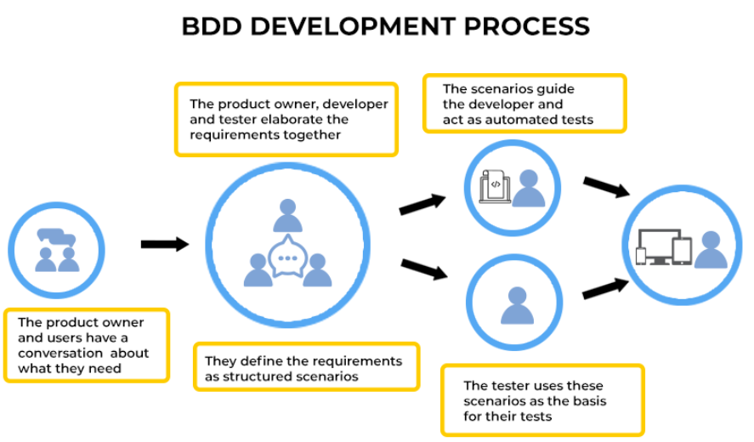
Behaviour driven development
https://www.spiceworks.com/tech/devops/articles/what-is-bdd/

Slide 75
Behaviour driven development
Advantages:
Customer driven product development – Early feedback, customer involvement
Proper prioritization of features - core product features, prioritize them, and segregate them as per requirements
Greater transparency - greater visibility of the system features so that all the developers, testers, business stakeholders, and other team members can clearly understand what is being developed
Reduced maintenance and project risk
Better alignment of overall business goal - As this development approach emphasizes the behavior of each feature, details about what purpose they serve, how well it fits in the current market, how it can drive more profits, etc., can be conveyed better.
https://www.spiceworks.com/tech/devops/articles/what-is-bdd/

Slide 76
Behaviour driven development process
The behavior-driven development process is based on three critical approaches:
Test first approach
Agile testing approach
Built-in quality approach
Test first approach
The test-first approach is focused on testing the product at the right time.
It requires the agility of the development, testing, and project teams as well as clarity regarding the technical process, principles, and methods adopted during various project development phases.
Agile testing approach
Agile testing is based on the famous iterative development and testing methodology where particular emphasis is put on the collaboration between customers and teams. Customers’ perspectives are considered during the development and testing process.

Slide 77
Behaviour driven development process
Built-in quality approach
Behavior-driven development adheres to a built-in quality approach, which ensures that the end product has all the required features and solutions and fits the current market. It is not enough to have a set of features and solutions; but it should be market-driven and customer-centric.
BDD mainly involves three phases: discovery, formulation, and automation.
Discovery phase
The discovery phase is the first phase of behavior-driven development, where the acceptance criteria are researched and decided. Generally, the product manager actively participates in behavior-driven development’s discovery phase.
In this stage, the acceptance criteria are crafted based on product type, key features, target audience, present market, and other factors. Other team members, such as the project manager, developer, tester, or operation team, contribute with their input. Overall, the discovery phase of behavior-driven development requires the collaborative efforts of team members to come up with the acceptance criteria.

Slide 78
Behaviour driven development process
Formulation phase
The formulation phase is mainly relevant when a backlog item is just about to get implemented.
The primary purpose of this phase is to ensure that the acceptance criteria are confirmed and ready to be applied in real-time. Acceptance tests in the formulation phase execute this part.
The purpose of acceptance testing is to run quality assurance methods to determine whether an application or product is as per the requirements.
Automation phase
Automates the process of acceptance tests. It optimizes the time taken and resources used while ensuring that the required outputs are obtained, and criteria are matched.

Slide 79
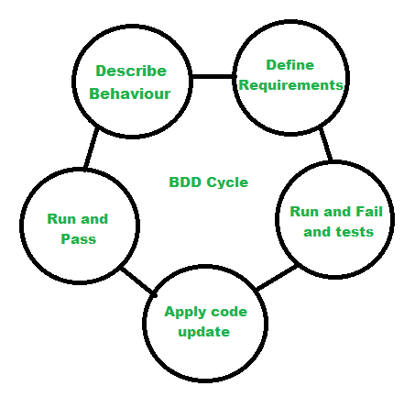
Behaviour driven development process
BDD Life Cycle
Describe behavior –This includes the flow and features of the product means the main vision.
Define requirements –Modeled requirements with business rules for a shared understanding.
Run and fail the tests –Develop and run the test cases.
Apply code update –Refactor it according to the requirement.
Run and pass the tests –Run the updated code and pass the test cases.
But the important point is that BDD is not about testing like TDD. BDD is all about achieving business goals and requirements.

Slide 80
Behaviour driven development process
Limitations of Behavioral-Driven Development
BDD can be time-consuming to create and maintain extensive documentation, including user stories, acceptance criteria, and step definitions
Involving all stakeholders, especially non-technical stakeholders, can be a challenge.
BDD tests heavily rely on the quality of initial requirements and user stories; incomplete or inaccurate requirements can lead to insufficient test coverage and bugs
BDD may not be suitable for short development cycles or projects with frequently changing requirements.

Slide 81
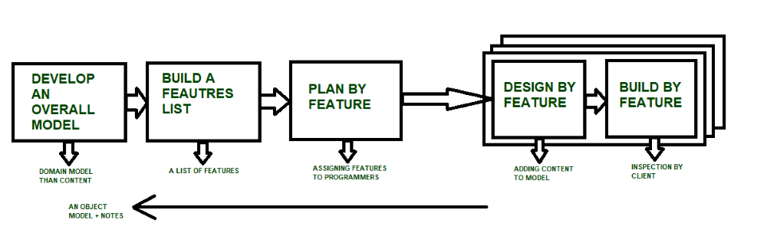
Feature driven development

Slide 82
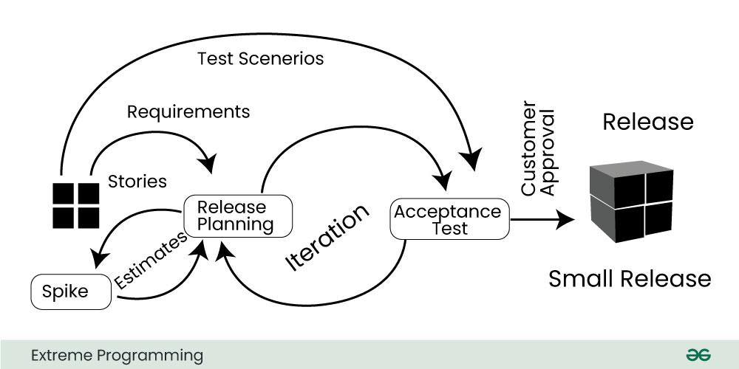
Extreme programming

Slide 83
difference between feature driven and test driven development
Feature-driven development (FDD):
Focus: FDD focuses on delivering features incrementally.
Process: It begins with an overall model of the system, which is refined into a detailed feature list. Each feature is then designed, implemented, and tested individually before being integrated into the system.
Iterations: Development occurs in short, time-boxed iterations, typically lasting 1-2 weeks.
Emphasis on Design: FDD emphasizes design up front, with an initial focus on creating a comprehensive feature list and a domain model.
Roles: FDD often involves specialized roles like Chief Architect, Chief Programmer, and Domain Experts.
Testing: While testing is a part of FDD, it's not as prominent as in TDD. Testing typically occurs after feature implementation.

Slide 84
difference between feature driven and test driven development
Test-driven development (TDD):
Focus: TDD focuses on writing tests before writing the code.
Process: Developers start by writing a failing automated test that defines a desired improvement or new function. Then, they write the minimum amount of code required to pass that test. Finally, they refactor the code to improve its design while ensuring that all tests continue to pass.
Iterations: TDD also operates in short iterations, typically with cycles lasting a few minutes to an hour.
Emphasis on Testing: Testing is central to TDD. By writing tests first, developers ensure that their code behaves as expected and that any changes made in the future don't introduce regressions.
Roles: TDD doesn't prescribe specific roles; instead, it's a practice that can be adopted by any member of a development team.
Continuous Integration: TDD often works hand-in-hand with continuous integration, where code changes are frequently integrated into a shared repository and automatically tested.

